Slide 1

Web Development & Design Foundations with H T M L 5
Ninth Edition
Chapter 2
H T M L Basics
Slides in this presentation contain hyperlinks. JAWS users should be able to get a list of links by using INSERT+F7
Copyright © 2019, 2017, 2015 Pearson Education, Inc. All Rights Reserved
Notes:
If this PowerPoint presentation contains mathematical equations, you may need to check that your computer has the following installed:
1) MathType Plugin
2) Math Player (free versions available)
3) NVDA Reader (free versions available)

Slide 2
Learning Objectives (1 of 2)
2.1 Describe H T M L, X H T M L, and H T M L 5
2.2 Identify the markup language in a web page document
2.3 Use the h t m l, head, body, title, and meta elements to code a template for a web page
2.4 Configure the body of a web page with headings, paragraphs, line breaks, divs, lists, and blockquotes
2.5 Configure text with phrase elements
2.6 Configure a web page using new H T M L 5 header, nav, main, and footer elements

Slide 3
Learning Objectives (2 of 2)
2.7 Configure special characters
2.8 Use the anchor element to link from page to page
2.9 Create absolute, relative, and e-mail hyperlinks
2.10 Code, save, and display a web page document
2.11 Test a web page document for valid syntax

Slide 4
What is H T M L?
H T M L: The set of markup symbols or codes placed in a file intended for display on a Web browser page.
The World Wide Web Consortium (http://w3c.org) sets the standards for H T M L and its related languages.

Slide 5
H T M L Elements
Each markup code represents an H T M L element.
Each element has a purpose.
Most elements are coded as a pair of tags: an opening tag and a closing tag.
Tags are enclosed in angle brackets, “<” and “>” symbols.

Slide 6
What is H T M L 5 ?
Newest version of H T M L / X H T M L
Supported by modern browsers
Intended to be backwards compatible
Adds new elements
Adds new functionality
Edit form data
Native video and audio
And more!
Source: W3C http://www.w3.org/html/logo/

Slide 7
Document Type Definition
Document Type Definition (D T D)
Doctype statement
Identifies the version of H T M L contained in your document.
Placed at the top of a web page document

Slide 8
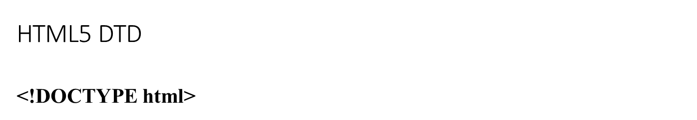
D T D Example

Slide 9
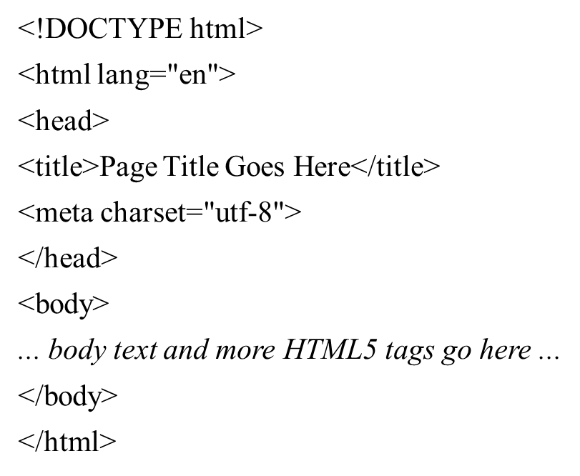
Example H T M L 5 Web Page
Notes:
Use lang attribute on html element - to declare the language of the Web page. This is meant to assist search engines and browsers.

Slide 10


Head & Body Sections
Head Section
Contains information that describes the web page document
Body Section
Contains text and elements that display in the web page document

Slide 11
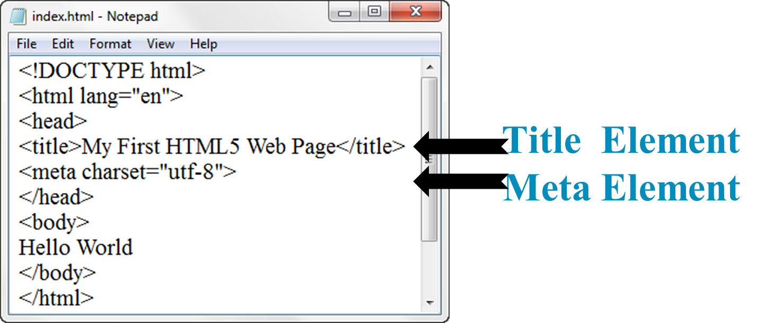
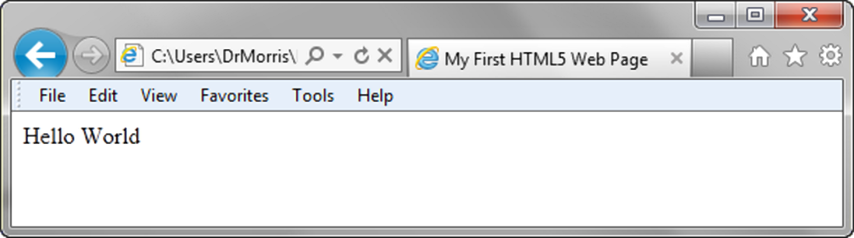
Title Element Meta Element

Slide 12
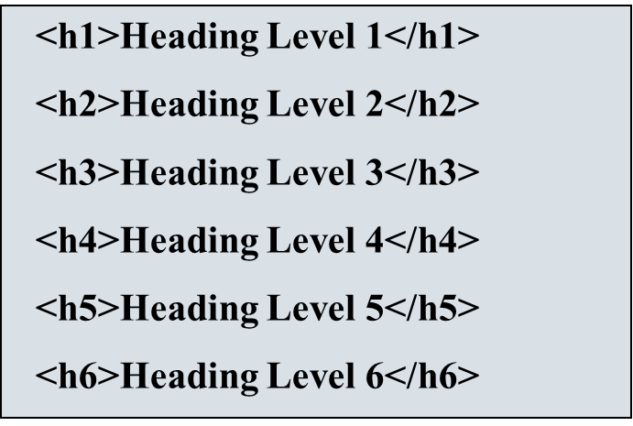
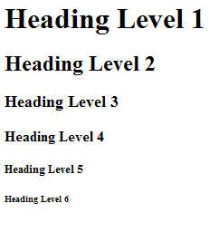
Heading Element

Slide 13
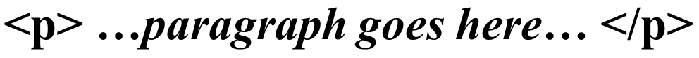
Paragraph Element
Paragraph element
Groups sentences and sections of text together.
Block Display – Configures empty space above and below

Slide 14
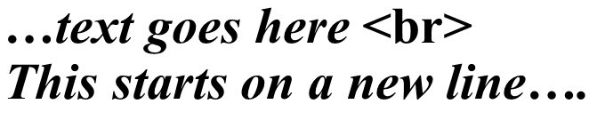
Line Break Element
Line Break element
Stand-alone, or void tag
Causes the next element or text to display on a new line

Slide 15
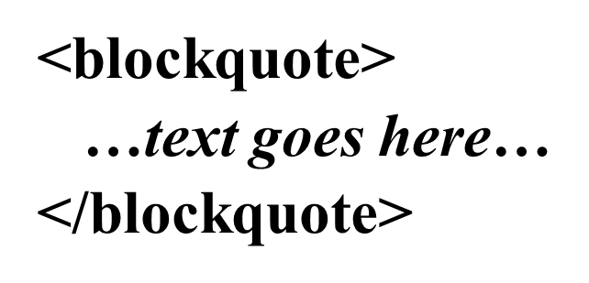
Blockquote Element
Blockquote element
Indents a block of text for special emphasis
Block Display – Configures empty space above and below

Slide 16
Phrase Elements
Indicate the context and meaning of the text.
Displayed right inline with the text.
Element | Example | Usage
<b> | bold text | Text that has no extra importance but is styled in bold font by usage and convention
<em> | emphasized text | Causes text to be emphasized in relation to other text; usually displayed in italics
<i> | italicized text | Text that has no extra importance but is styled in italics by usage and convention
<mark> | mark text | Text that is highlighted in order to be easily referenced (HTML5 only)
<small> | small text | Legal disclaimers and notices (“fine print”) displayed in small font-size
<strong> | strong text | Strong importance; causes text to stand out from surrounding text; usually displayed in bold
<sub> | _{sub} text | Displays a subscript as small text below the baseline
<sup> | ^{sup} text | Displays a superscript as small text above the baseline

Slide 17
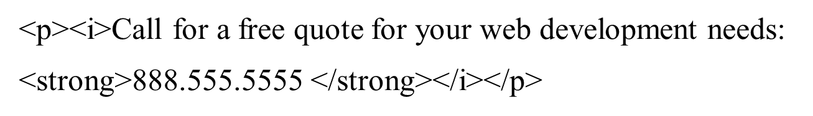
Proper Nesting
Code:
Browser display:

Slide 18
H T M L Lists
Unordered List
Ordered List
Description List formerly called a definition list

Slide 19
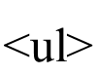
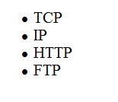
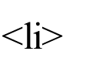
Unordered List
Displays a bullet, or list marker, before each entry in the list.
Contains the unordered list
Contains an item in the list

Slide 20
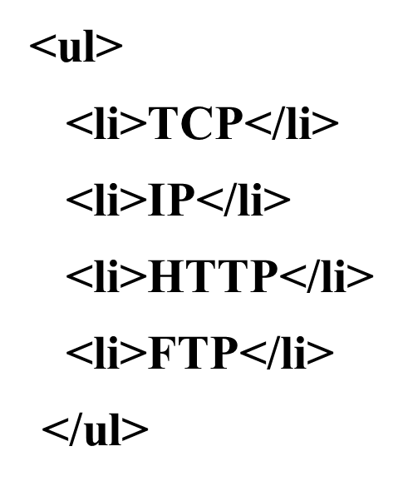
Unordered List Example

Slide 21
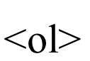
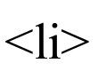
Ordered List
Displays a numbering or lettering system to itemize the information contained in the list
Contains the ordered list
type attribute determines numbering scheme of list, default is numerals
Contains an item in the list

Slide 22
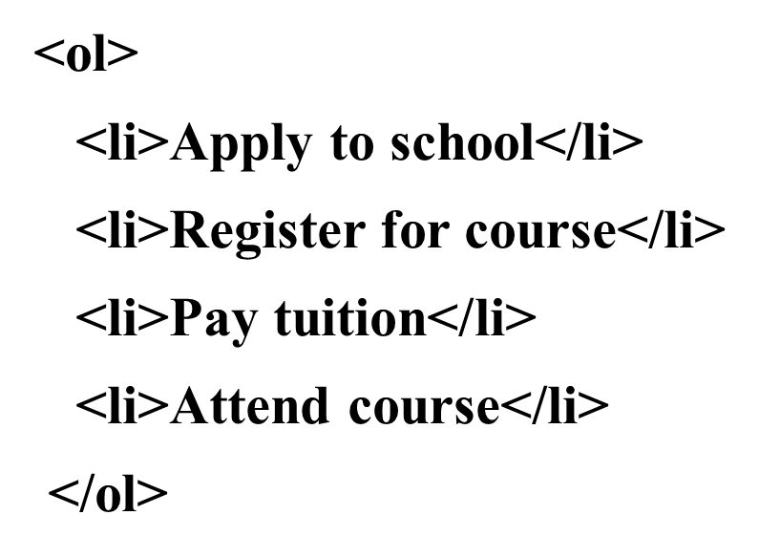
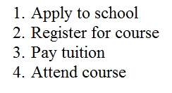
Ordered List Example

Slide 23
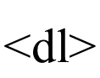
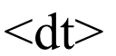
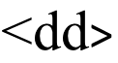
Description List
Useful to display a list of terms and descriptions or a list of F A Q and answers
Contains the description list
Contains a term/phrase/sentence
Configures empty space above and below the text
Contains a description of the term/phrase/sentence
Indents the text
Configures empty space above and below the text

Slide 24
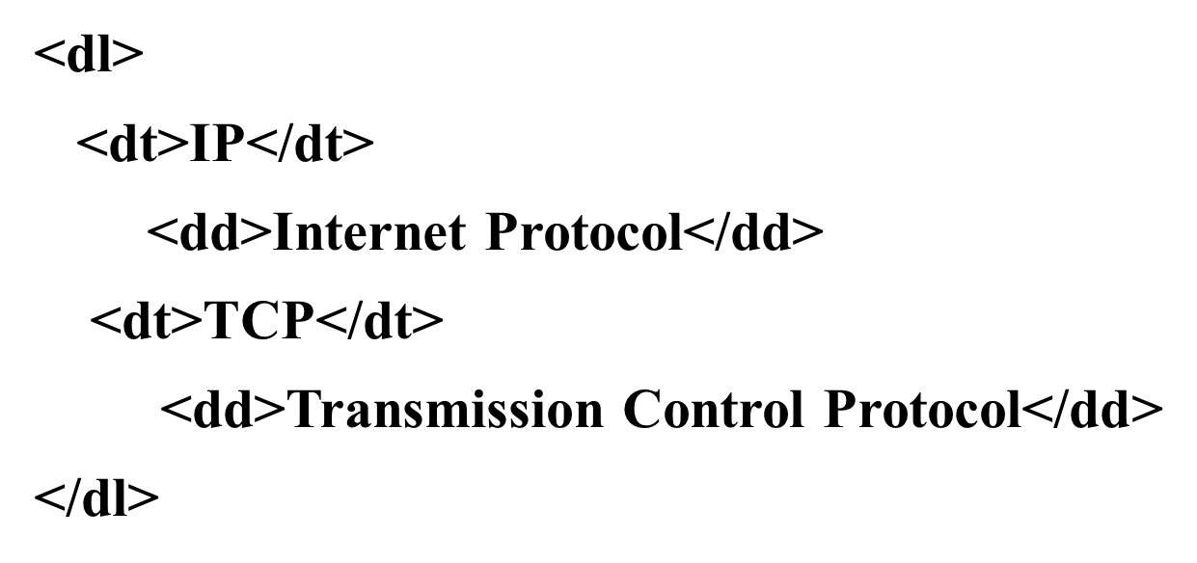
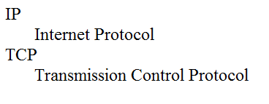
Description List Example

Slide 25
Checkpoint 2.1
Describe the features of a heading element and how it configures the text.
Describe the difference between ordered lists and unordered lists.
Describe the purpose of the blockquote tag.

Slide 26
Special Characters
Display special characters such as quotes, copyright symbol, etc.
Character | Code
© | &copy;
< | &lt;
> | &gt;
& | &amp;
& | &nbsp;

Slide 27
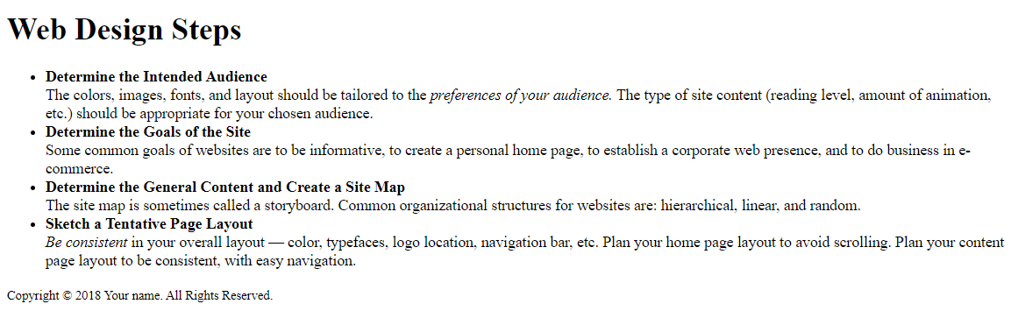
Example 1 (use ex1.html)

Slide 28
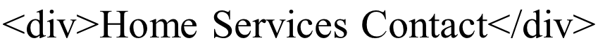
Div Element
Configures a structural block area or “division” on a web page with empty space above and below.
Can contain other block display elements, including other div elements

Slide 29
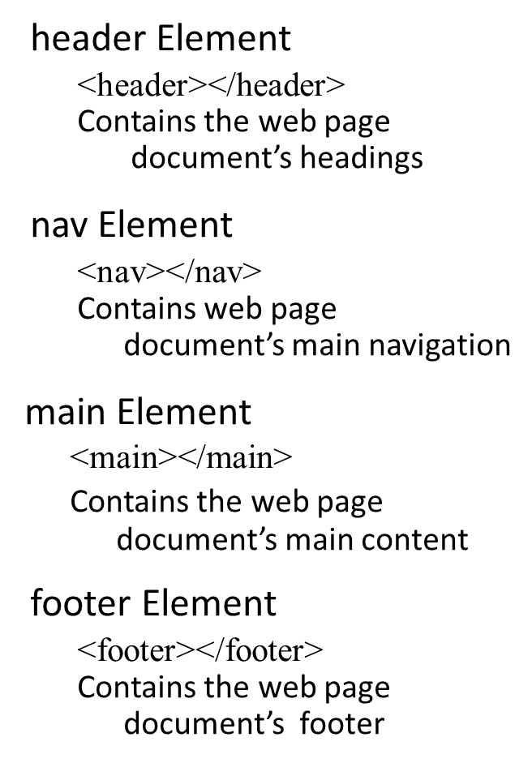
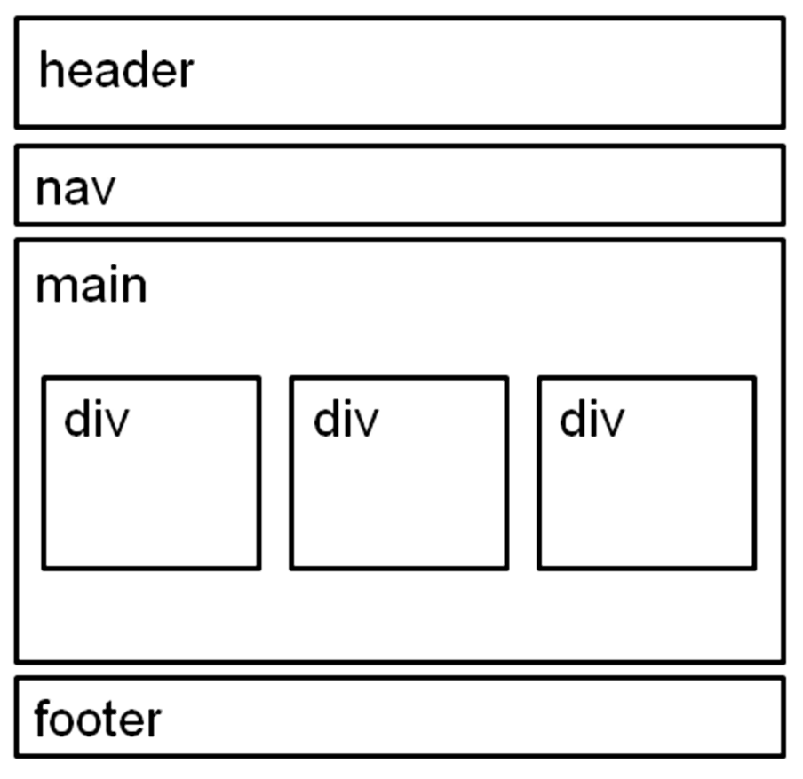
H T M L 5 Structural Elements (1 of 2)
Notes:
These are used to structure web page documents in a more meaningful manner

Slide 30
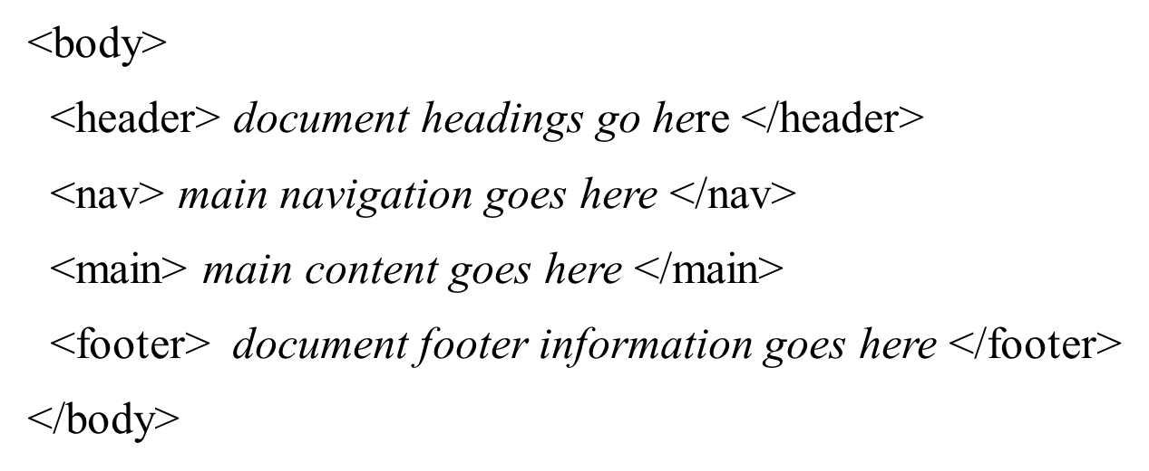
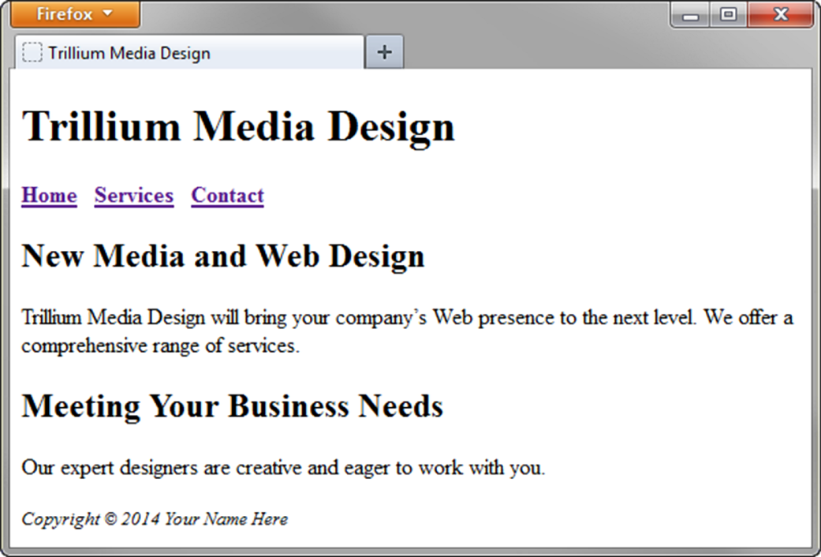
H T M L 5 Structural Elements (2 of 2)

Slide 31
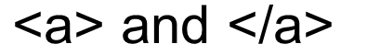
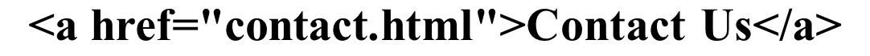
Anchor Element
Specifies a hyperlink reference (href) to another webpage or file that you want to display
Text between the
is displayed on the web
page as a hyperlink and is underlined.
h ref Attribute
Used to configure the hyperlink reference
Indicates the file name or U R L

Slide 32
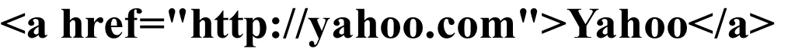
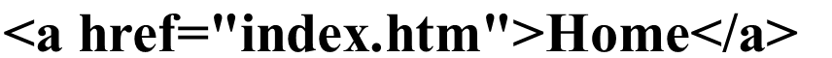
Absolute & Relative Hyperlinks
Absolute link
Link to a different website
Relative link
Link to pages on your own site

Slide 33
E-Mail Hyperlink
Automatically launch the default mail program configured for the browser
If no browser default is configured, a message is displayed

Slide 34
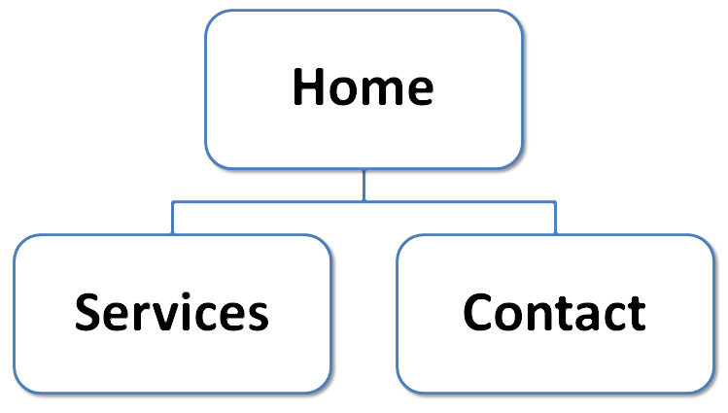
Hyperlinks
Hands-On Practice

Slide 35
Checkpoint 2.2
Describe the purpose of special characters.
Describe when to use an absolute link. Is the http protocol used in the href value?
Describe when to use a relative link. Is the http protocol used in the href value?

Slide 36
Writing Valid H T M L
Check your code for syntax errors
Benefit:
Valid code → more consistent browser display
W3C H T M L Validation Tool
http://validator.w3.org

Slide 37
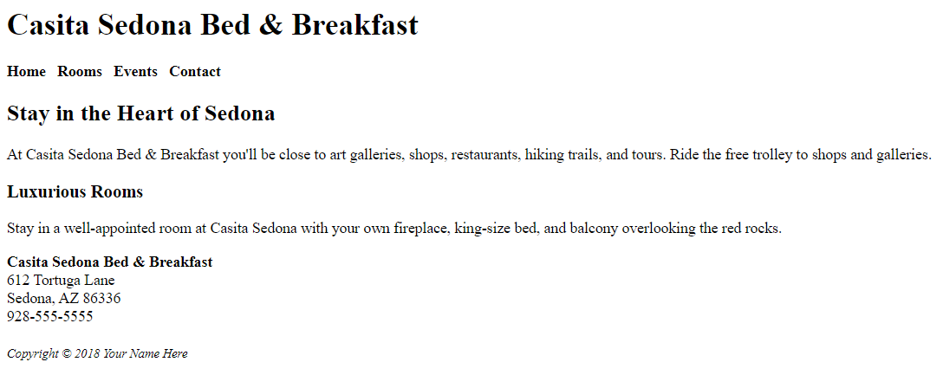
Example 2 (use ex2.html)

Slide 38
Summary
This chapter introduced you to H T M L.
You will use these skills over and over again as you create web pages.

Slide 39

Copyright

